Slide 1
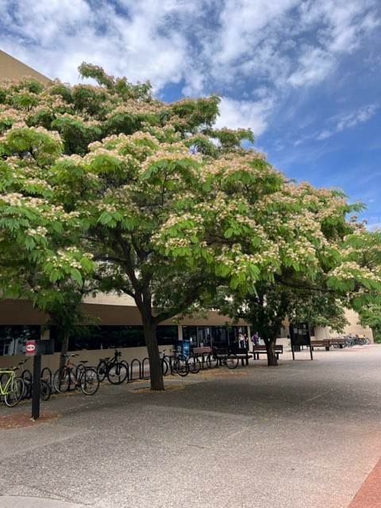
UNM HSLIC
Special Collections

Slide 2
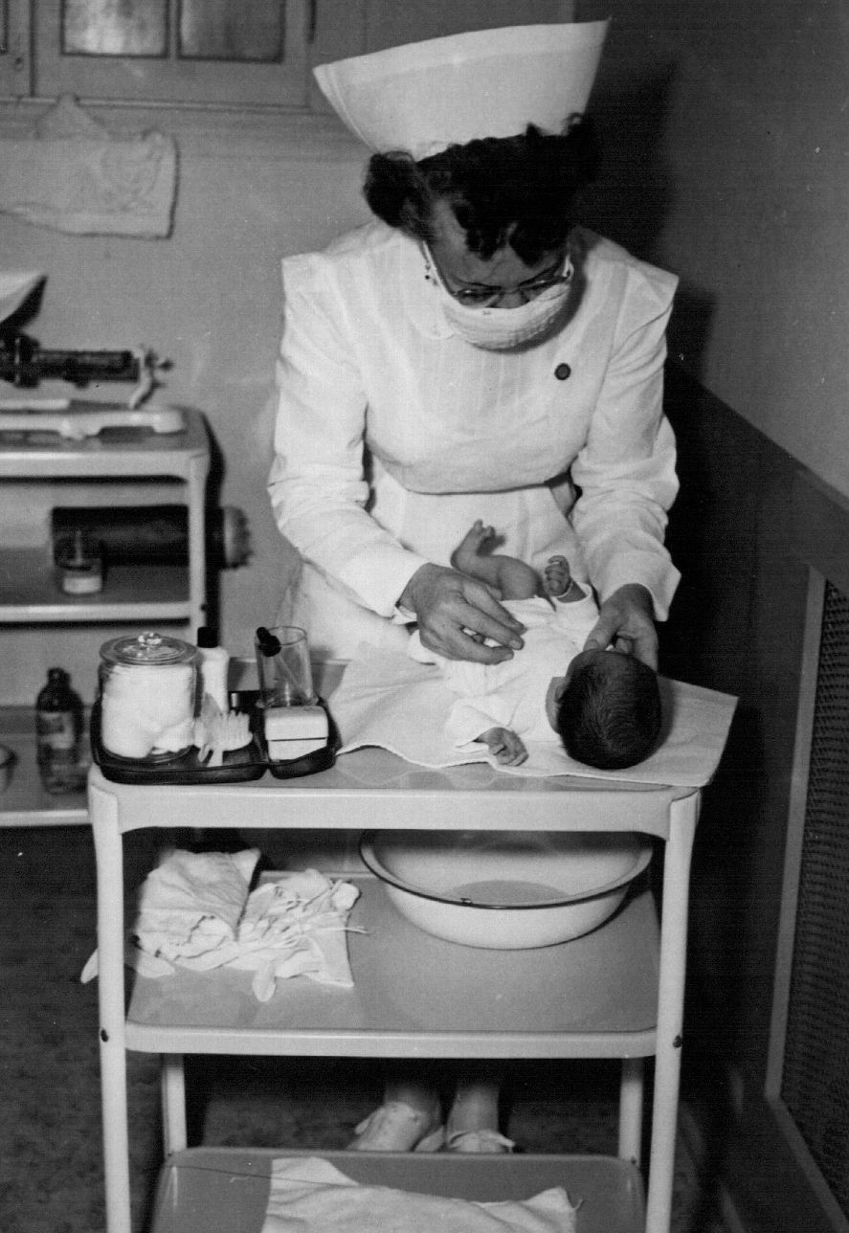
Collecting strengths
History of health and healthcare in New Mexico
      History of providers
      Oral histories
      Tuberculosis
      Public health
      Midwifery
      HSC history
Cradle Home Hospital Nursery, Regina School of Nursing

Slide 3
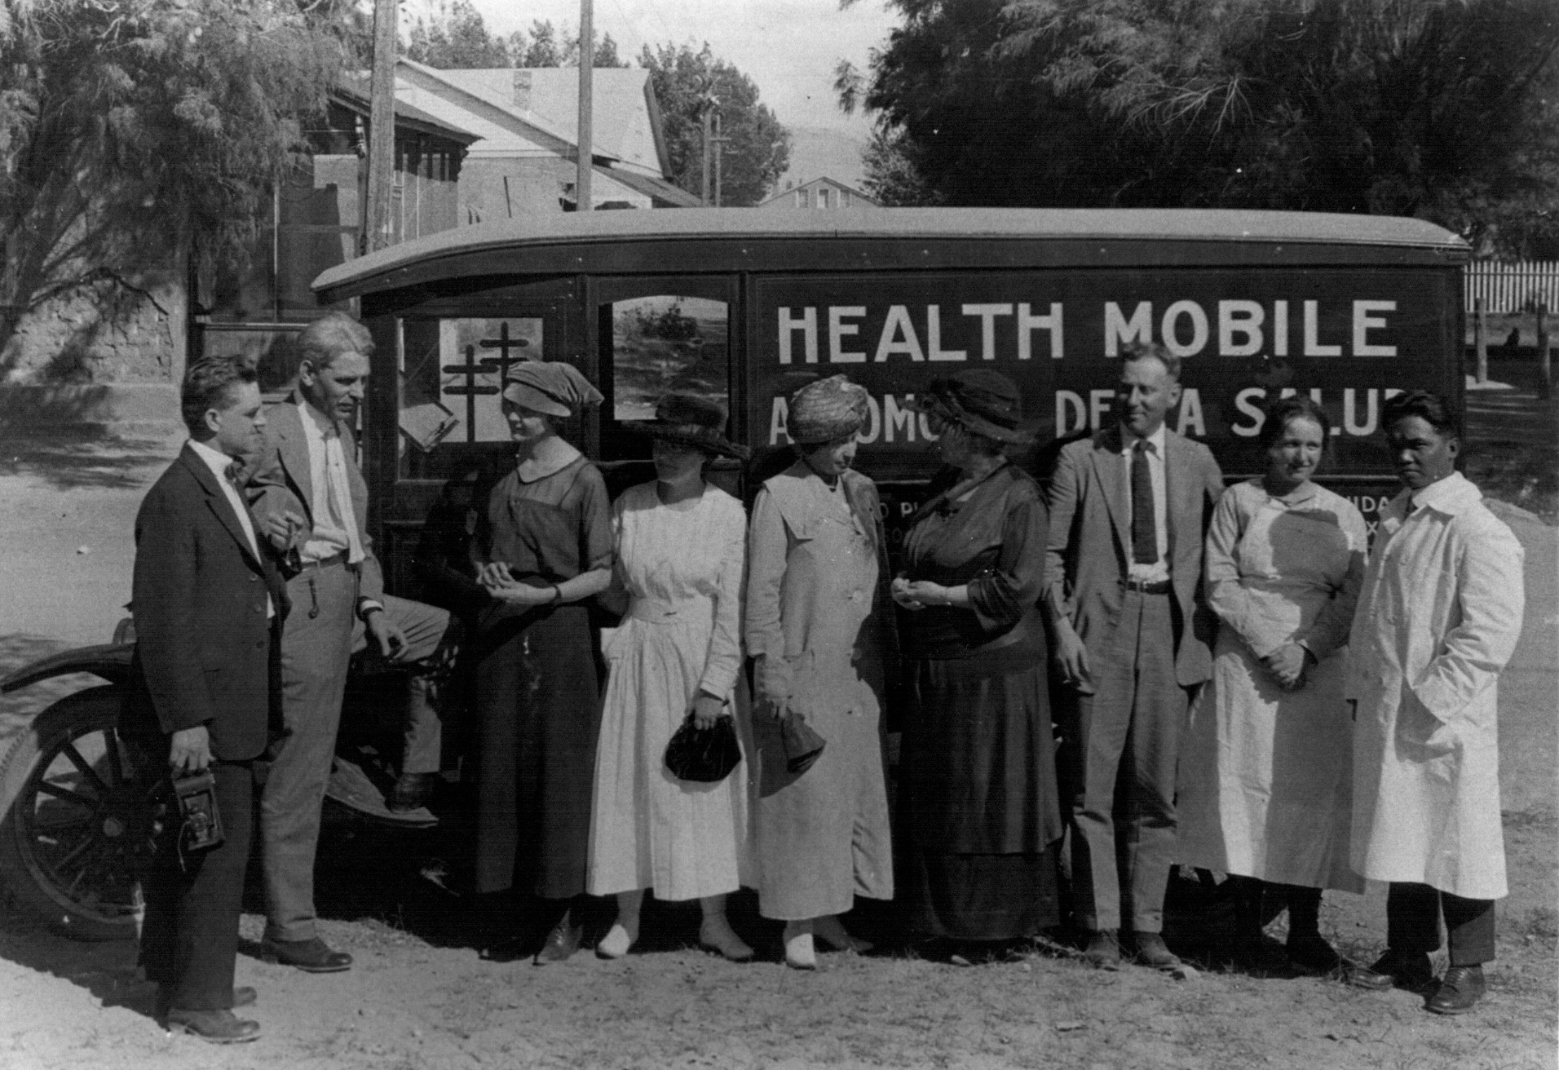
HSLIC Special Collections
340+ archival collections
Photographs
Artifacts
Oral histories
Books
NM physicians and nurses in front of the Health Mobile, 1920

Slide 4
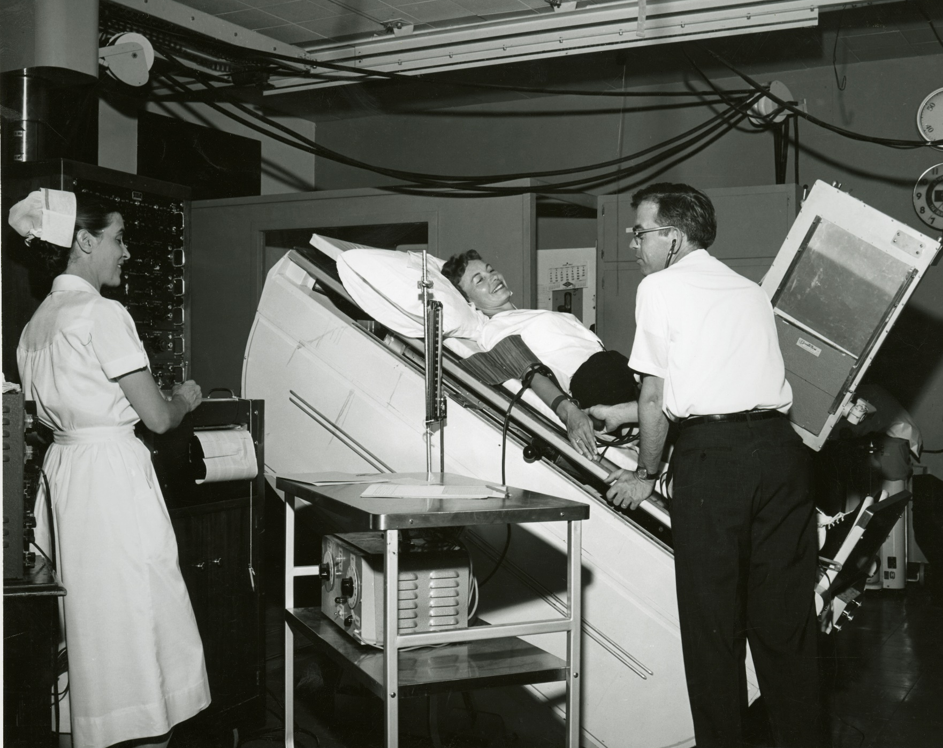
Accessing materials
  Appointment only
  SPC Webpage:
  https://hsc.unm.edu/hslic/resources/special-collections.html
Women in Space astronaut medical evaluation, Lovelace Clinic, 1960

Slide 5
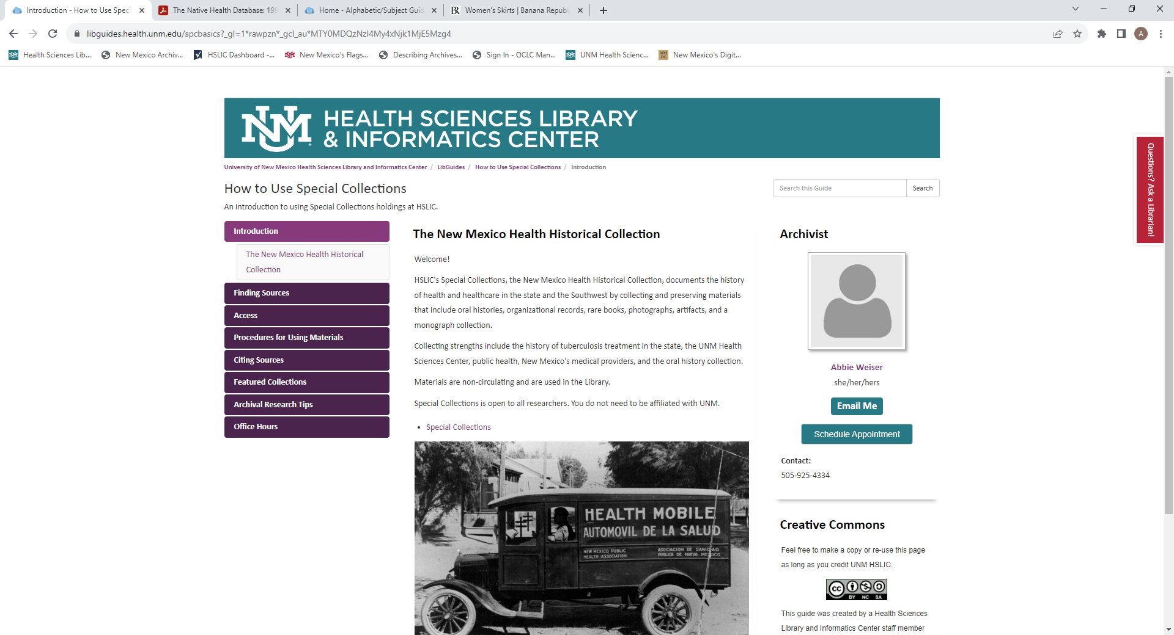
Special Collections research guide

Slide 6
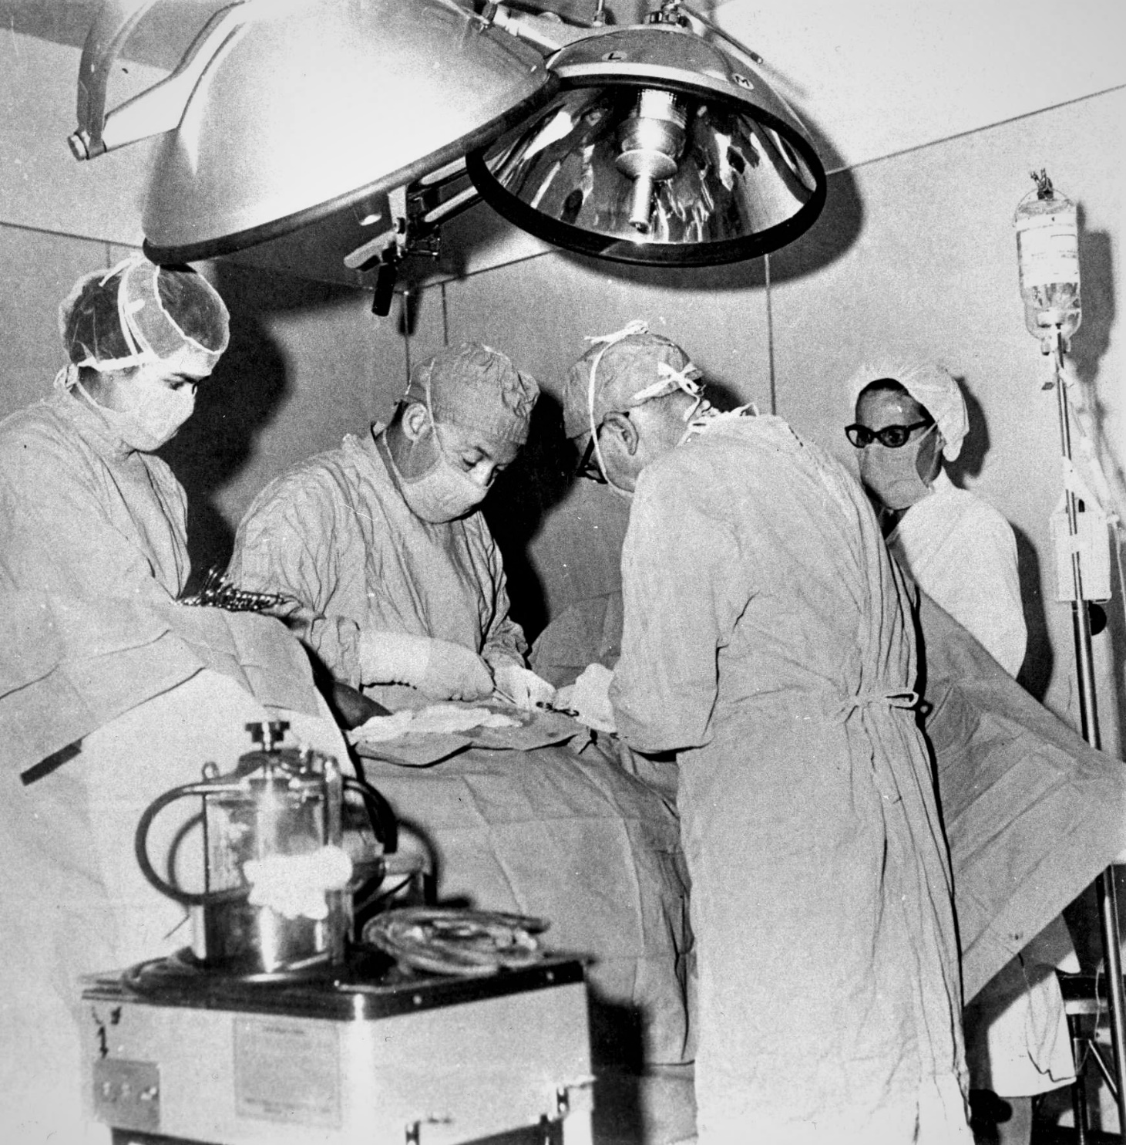
Online sources
UNM HSC Digital Repository
New Mexico Digital Collections
Archive-It
New Mexico Archives Online
Dr. Ziegler doing surgery, Española, 1949

Slide 7
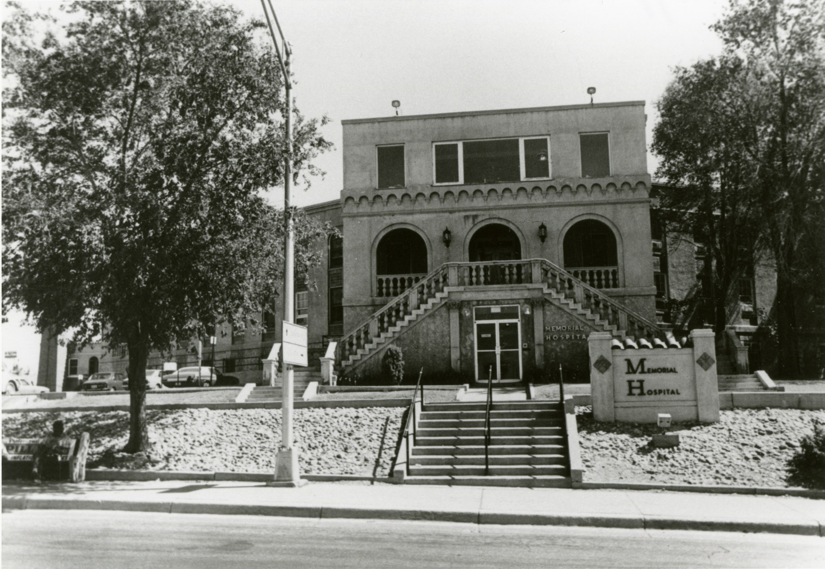
Questions?
Memorial Hospital, Albuquerque

