Slide 1
Archives & Special Collections
Dylan McDonald
New Mexico Library Association
Archives and Archivists SIG

Slide 2
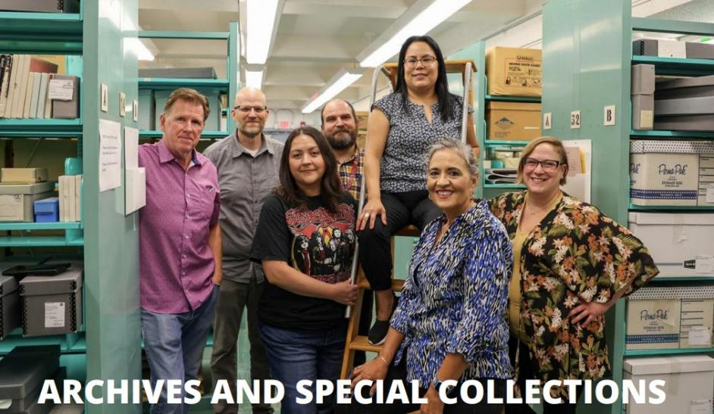

Slide 3
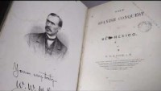
About NMSU Library Archives & Special Collections https://youtu.be/SpJ2y45ot30

Slide 4
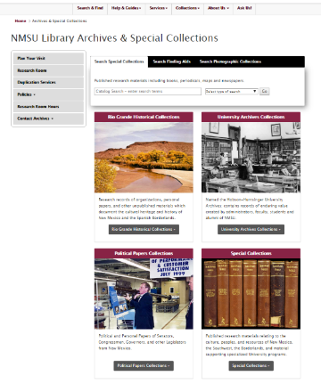
NMSU Library Archives & Special Collections library.nmsu.edu/archives
Collecting Scope
Four distinct units:
Rio Grande Historical Collections (RGHC)
University Archives
Special Collections
Political Collections

Slide 5
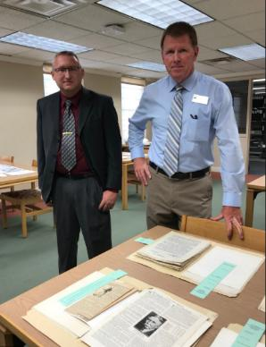
Conducting Research @ NMSU https://library.nmsu.edu/archives/planvisit.html
Open M-F 9 to 4
Parking
Making an Appointment
Reference Interview
Registration Process
Conditions of Use
Reproductions & Fees
Restrictions
Matt Friedberg & Dennis Daily

Slide 6
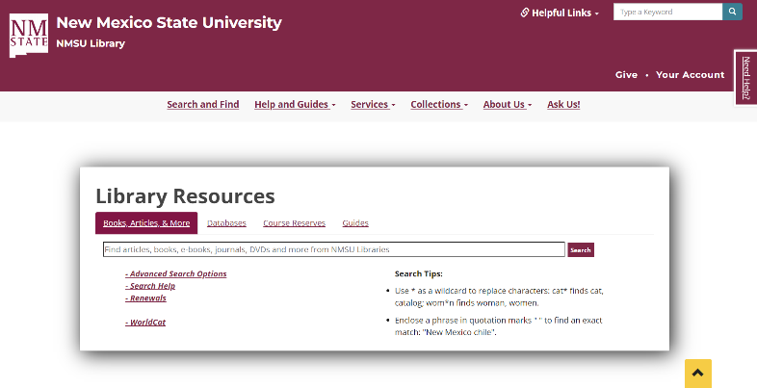
NMSU Library Catalog - ALMA https://library.nmsu.edu

Slide 7
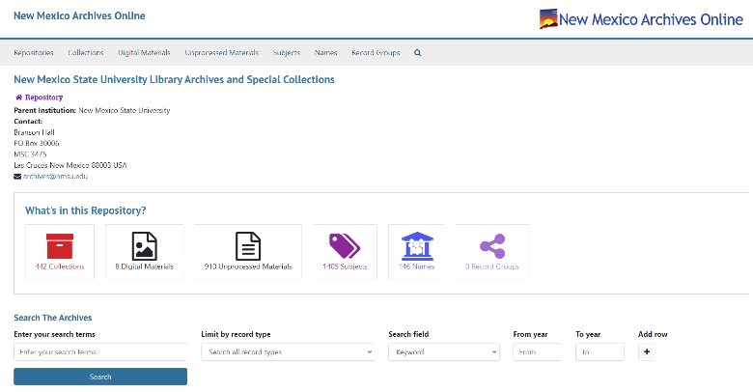
New Mexico Archives Online https://nmarchives.unm.edu/repositories/18

Slide 8
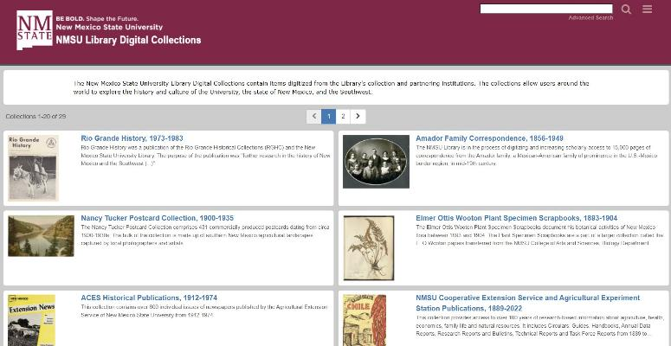
Digital Collections - CONTENTdm https://nmsu.contentdm.oclc.org

Slide 9
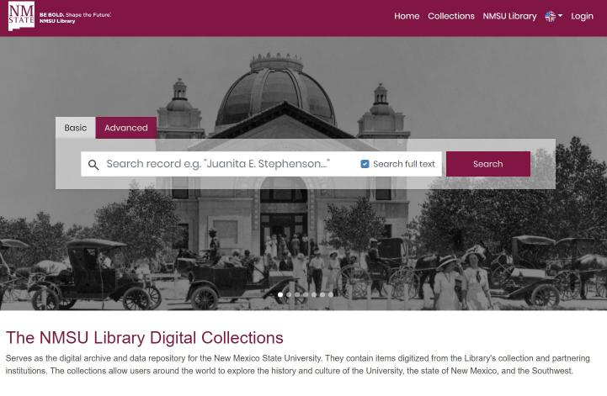
Digital Collections - OpenAccess https://oa.nmsu.libnova.com

Slide 10
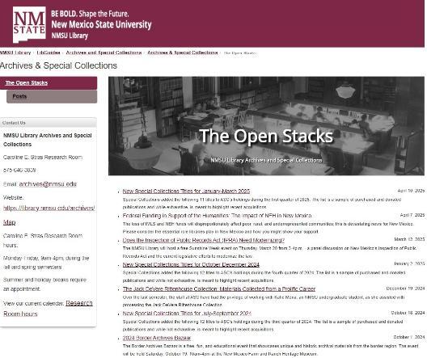
Open Stacks Blog https://openstacks.nmsu.edu

Slide 11
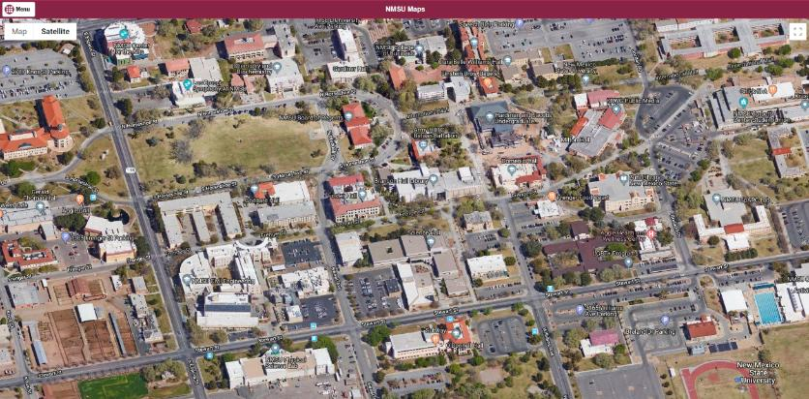
Branson Library, 4th Floor
1305 Frenger Mall, Rm 207
PO Box 30006, Dept. 3475
Las Cruces, NM 88003-8006
(575) 646-3839 or archives@nmsu.edu

Slide 12
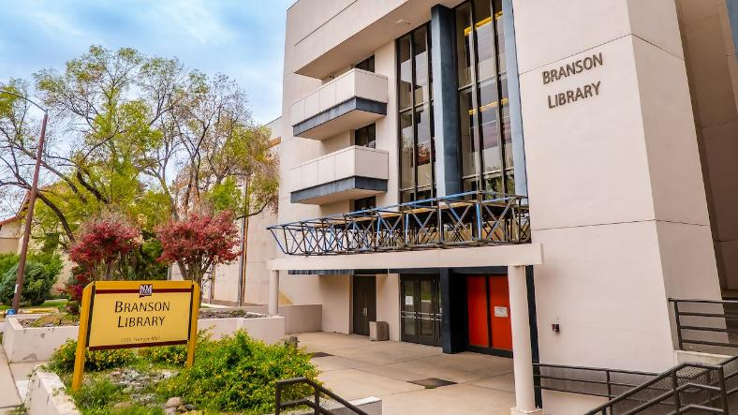
Branson Library

Slide 13
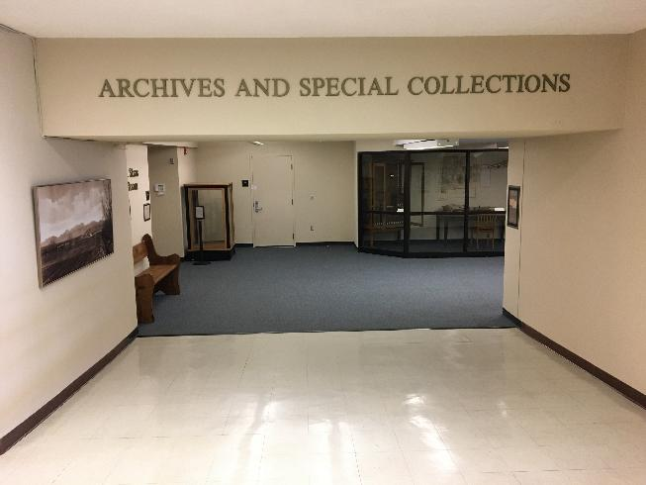
Branson Library
4th Floor East End

Slide 14
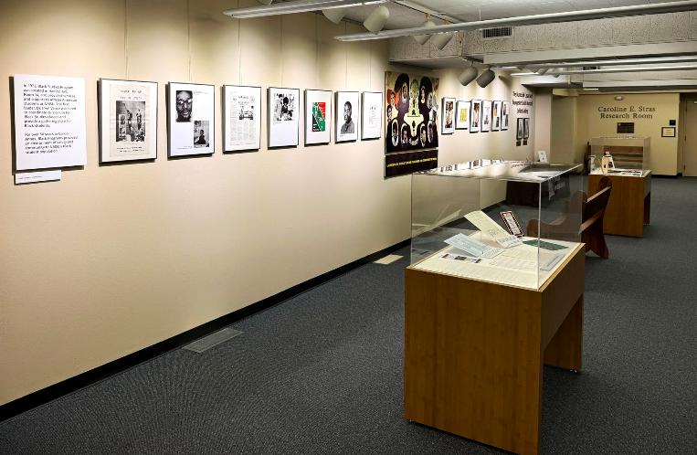
Humboldt Casad and Evangeline Smith Mandell Gallery

Slide 15
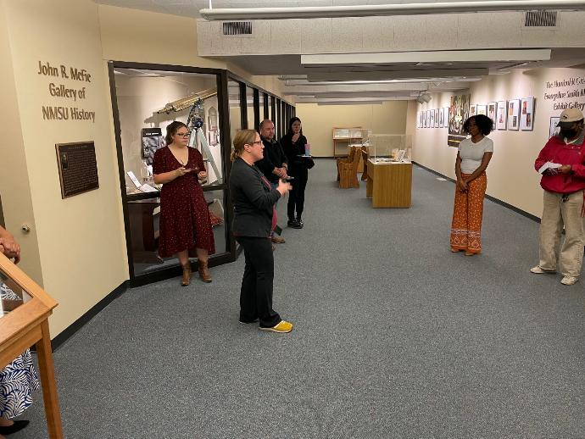
John R. McFie Gallery of NMSU History

Slide 16
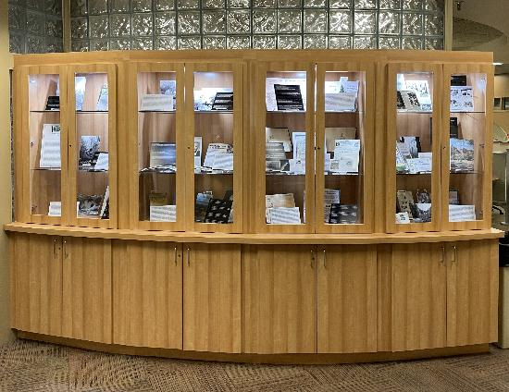
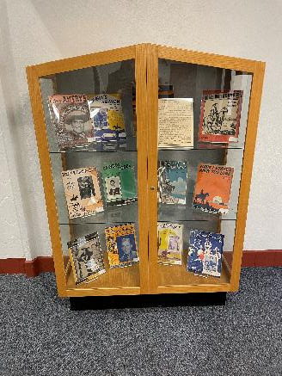
Branson & Zuhl Library Exhibit Spaces

Slide 17
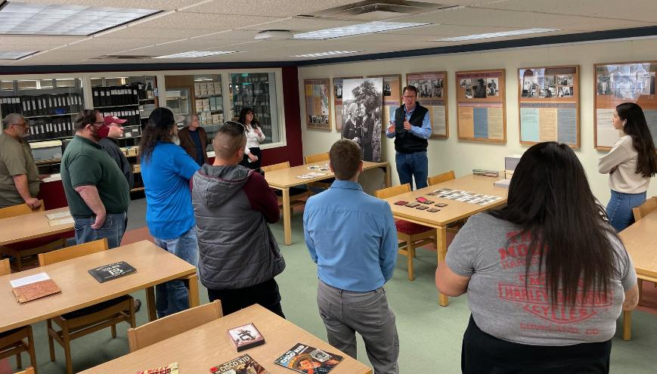
Caroline E. Stras Research Room

Slide 18
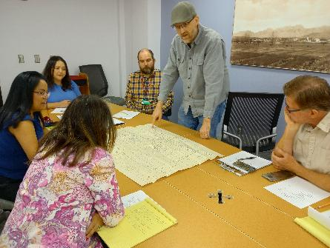
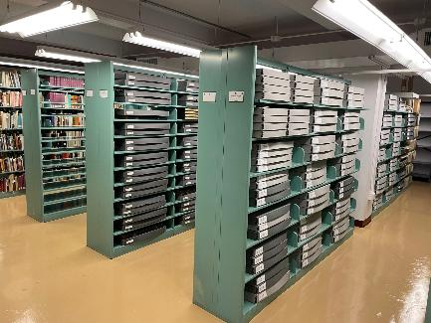
2nd Floor
Staff Offices & Conference Room
Special Collections & Political Collections

Slide 19
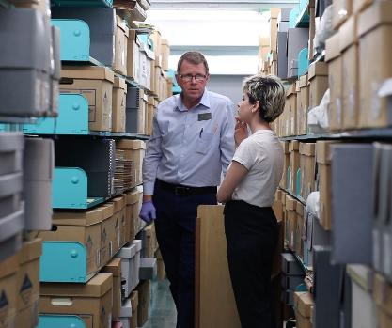
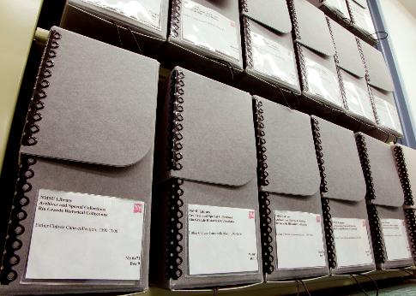
3rd Floor
Staff Offices
Rio Grande Historical Collections

Slide 20
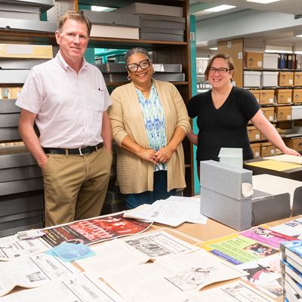
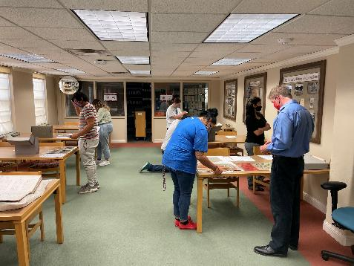
4th Floor
Staff Offices, Research Room, & Exhibits
University Archives

Slide 21
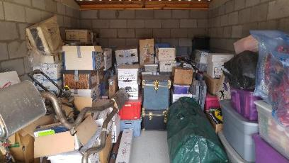
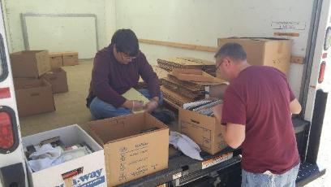
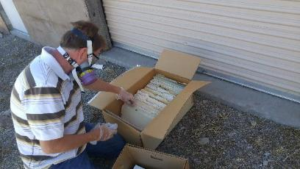
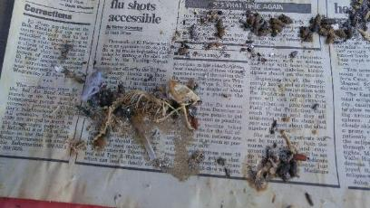
Acquisition of the papers of Wendell Chino, Mescalero Apache Leader

Slide 22
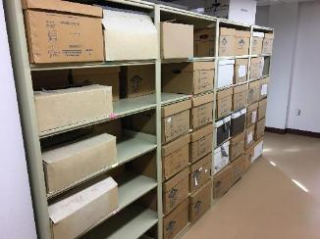
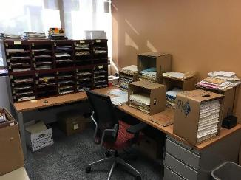
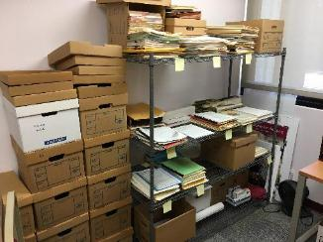
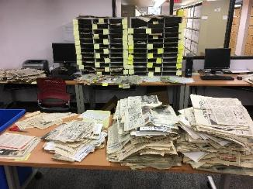
Sorting of Chino papers

Slide 23
Questions?

Slide 24
NMSU Library Archives & Special Collections
http://library.nmsu.edu/archives
Dylan McDonald, CA
Political Collections Archivist/Special Collections Librarian
(575) 646-7711
dylanmcd@nmsu.edu

